Slide 1
GUI Apps with Python and GTK
Let’s Build a Calculator!

Slide 2
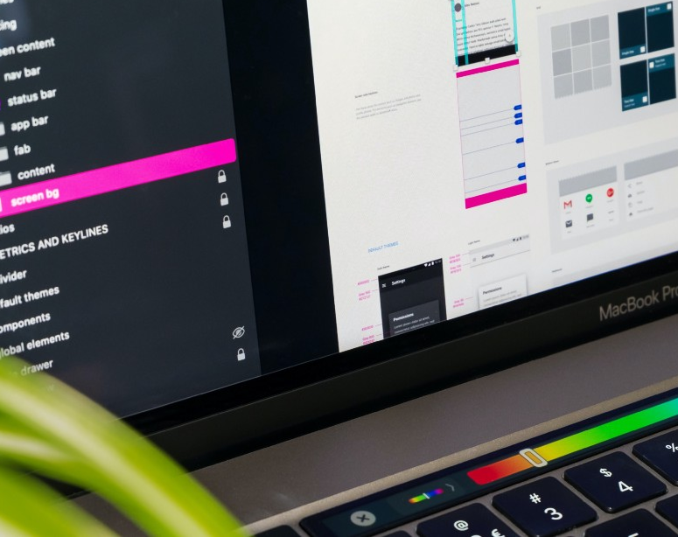
Graphical User Interface
A GUI allows users to interact through graphical displays
Good ones greatly enhance the efficiency and ease of using apps
They are built using a GUI Toolkit

Slide 3
GUI Apps vs. Others
Command line apps are great for working with your own code as a developer, steep learning curve
Web-based apps are normally best for consumption of information
GUI apps are great for giving to others to use, where they’ll want to interact locally on their own device

Slide 4


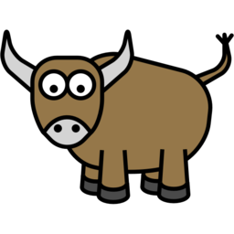
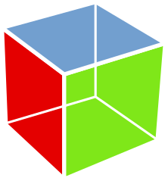
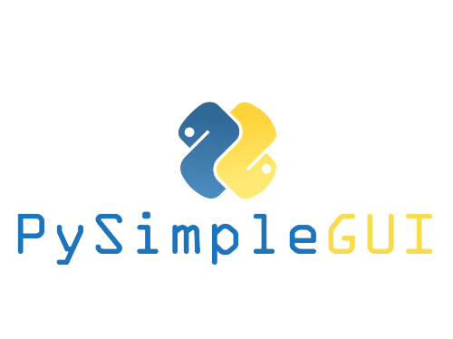

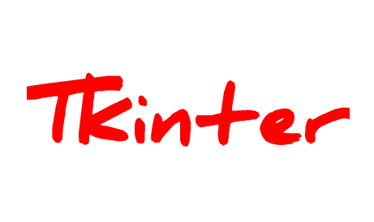
Python Options
Tkinter – built into standard library, not very modern
PyQt and PySide wraps C++ based Qt
wxPython wraps C++ based wxWidgets
PySimpleGUI wraps the 3 above to simplify GUI creation
Kivy is aimed for building games with highly customizable interfaces
Toga native across platforms, in early development
PyGObject (focus of this talk), wraps C based GTK

Slide 5

GTK
Originally created as the GIMP toolkit, very popular for Linux app development and basis for GNOME
Full featured GUI toolkit
A little harder to get setup in Windows, no mobile platform support
Latest release is 4.6.6, we’ll use that today

Slide 6
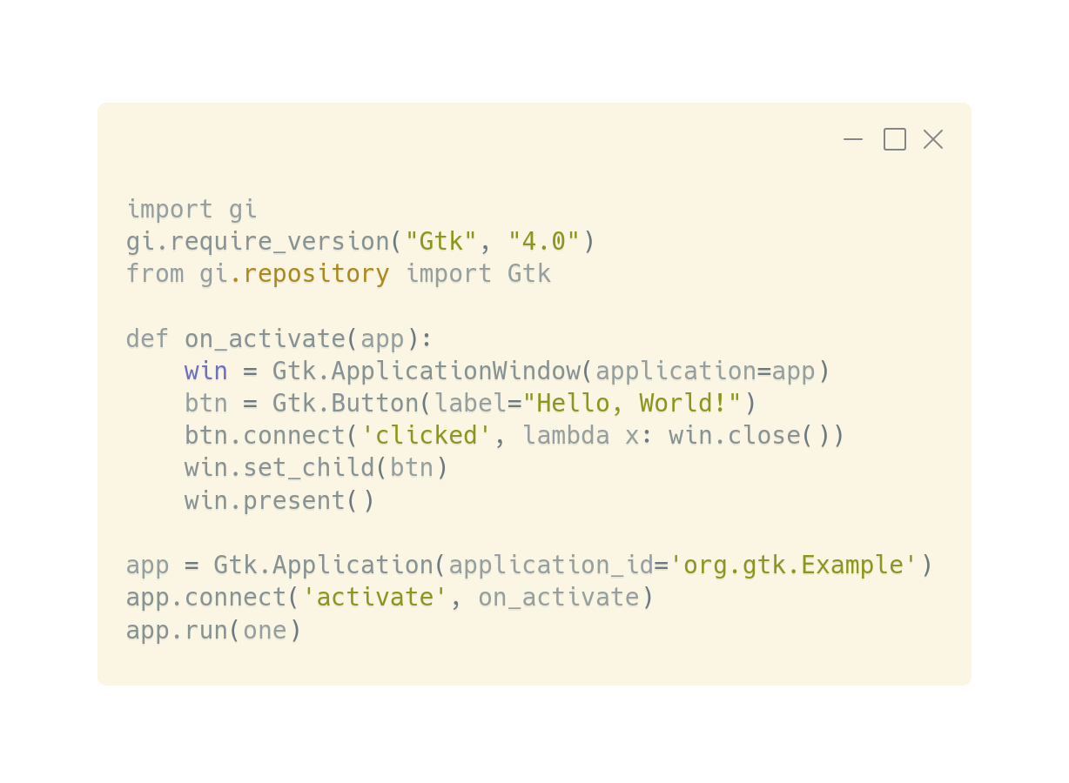

Hello World

Slide 7

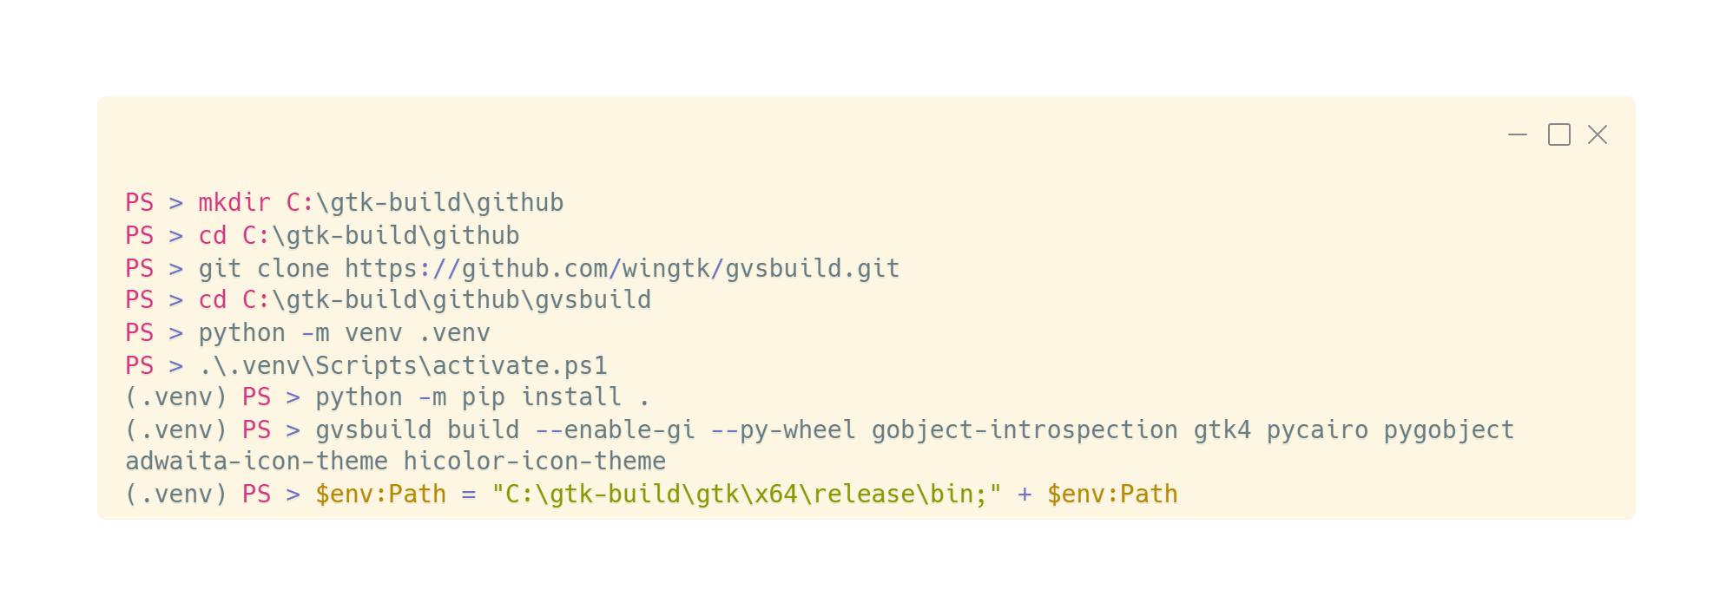
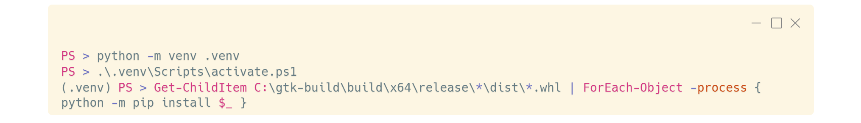
Windows with gvsbuild

Slide 8
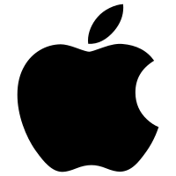
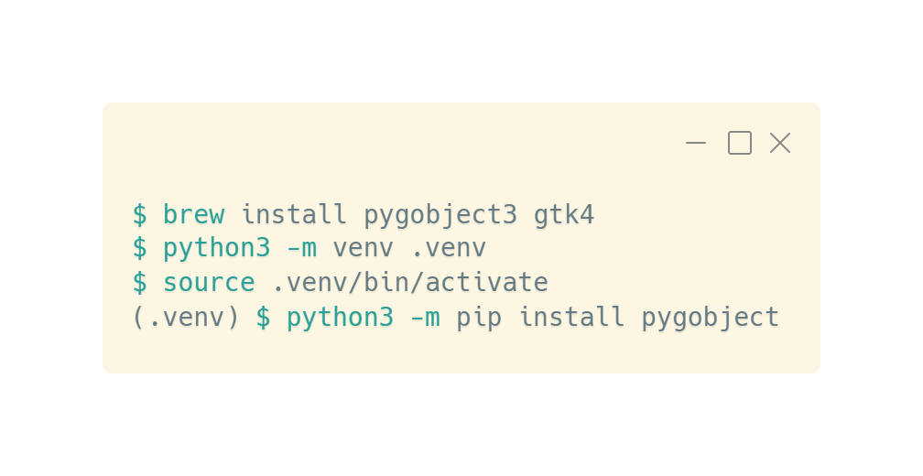
macOS
Go to https://brew.sh and install homebrew

Slide 9
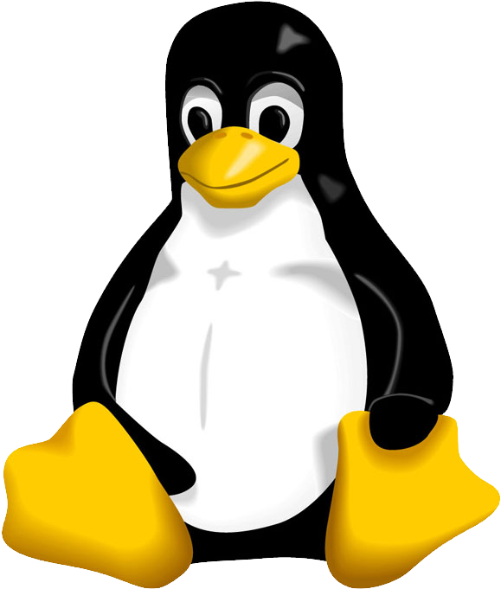
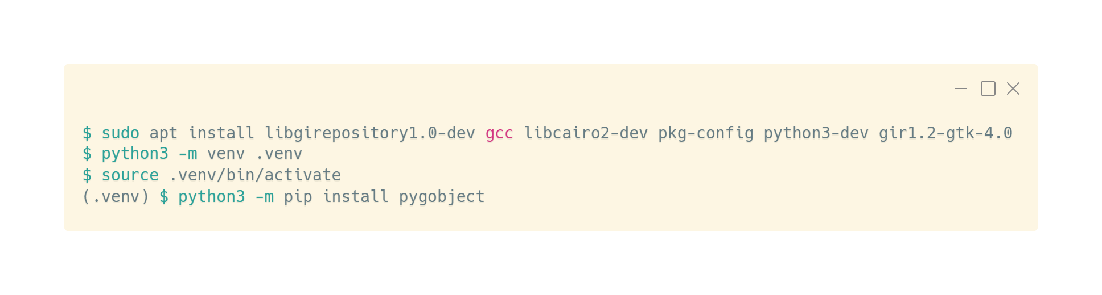
Linux

Slide 10

Visual GUI Building
Visually building up GUIs is helpful for rapid development
Cambalache is the new replacement for Glade
Installable with Flathub with Linux
macOS and Windows would need to build from source

Slide 11
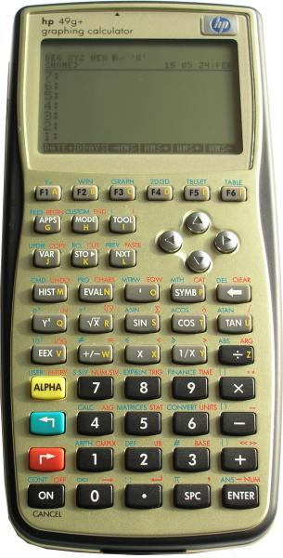
RPN Calculator
Today we’ll be building a simple RPN Calculator
RPN stands for Reverse Polish Notation, and is common with calculators produced by HP
To add two numbers
2
Enter
2
+
Faster calculations with fewer parenthesis and errors

Slide 12
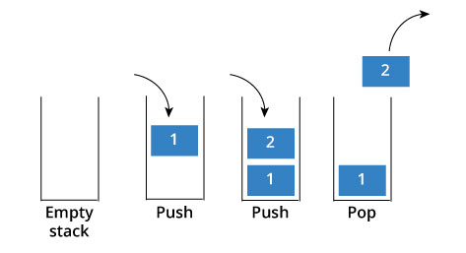
RPN Uses a Stack

Slide 13
Let’s Build It!

